Slide 1

Time Series Analysis of Bitcoin Prices Using s3fs
Karthik Vakada
DATA605 – Final Project
Spring 2025
REAL-TIME ANALYSIS AND FORECASTING OF BITCOIN PRICES WITH S3 AND PYTHON
MAY 2025

Slide 2

Motivation & Objective
BITCOIN IS HIGHLY VOLATILE—TRACKING IT HELPS INVESTORS AND ANALYSTS.
OBJECTIVE: ANALYZE AND FORECAST BITCOIN PRICES USING TIME SERIES TECHNIQUES.
ALSO BUILD A DASHBOARD TO VISUALIZE REAL-TIME INSIGHTS.
Researcher

Slide 3





Tech Stack & Tools
PYTHON LIBRARIES
S3FS
COINGECKO API
FLASK
Pandas, Statsmodels, Matplotlib, Plotly
Read/write files to AWS S3 like local storage
Real-time Bitcoin data collection
Deploying dashboard on local server

Slide 4
FETCH DATA USING COINGECKO API
STORE DATA LOCALLY AND OPTIONALLY TO S3 VIA S3FS
Pipeline
ANALYZE TREND, SEASONALITY, AND ANOMALIES
FORECAST PRICES AND VISUALIZE
DEPLOY INSIGHTS ON FLASK DASHBOARD

Slide 5
Data Collection
Used fetch_bitcoin_data.py to call CoinGecko API
Saved 365 days of prices into bitcoin_prices.csv
Output also uploaded to S3 bucket: bitcoin-timeseries-data-kv
Preview of the raw data:
Columns: Date, Price (USD)
Sample: 2024-05-01, 62924.87

Slide 6
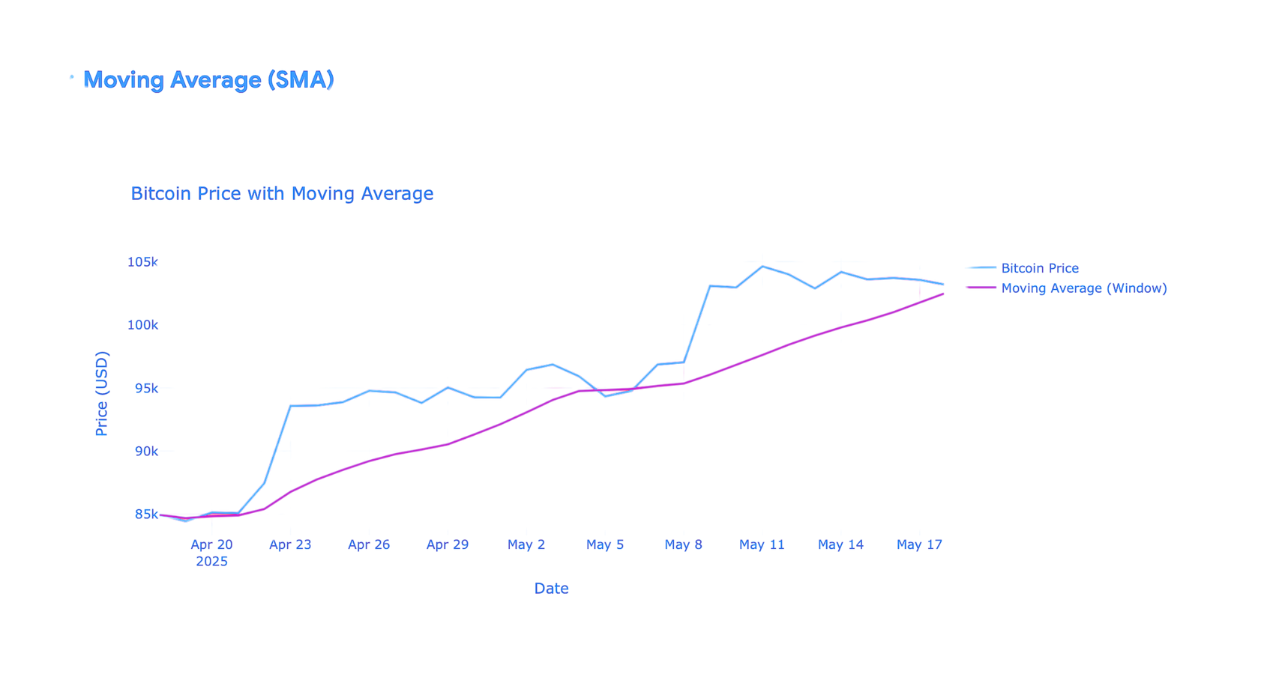
Preprocessing & Trend Analysis
PERFORMED STL DECOMPOSITION: TREND, SEASONAL, RESIDUAL
GENERATED 5-DAY MOVING AVERAGE FOR SMOOTHER INSIGHTS
VISUALIZED PATTERNS OVER TIME

Slide 7
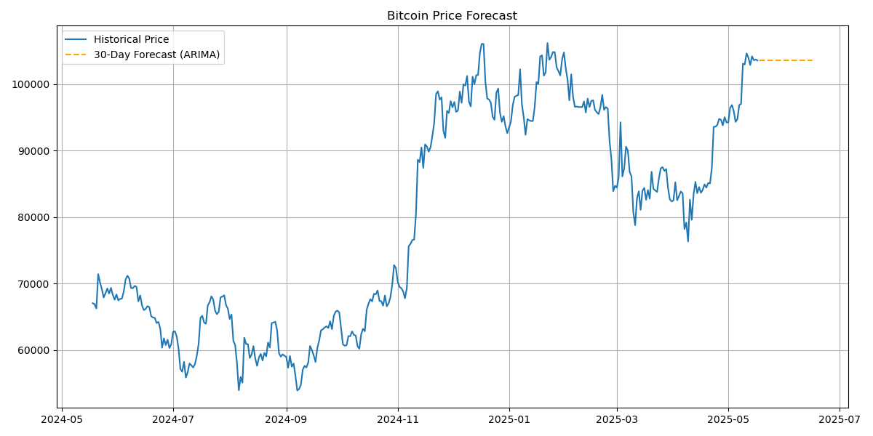
Forecasting with ARIMA
USED ARIMA TO PREDICT 30-DAY FUTURE PRICES
PLOTTED FORECAST WITH CONFIDENCE INTERVALS AND PLOTTED WITH CONFIDENCE INTERVALS (95%)
OUTPUT SAVED IN BITCOIN_PRICES_WITH_FORECAST.CSV

Slide 8
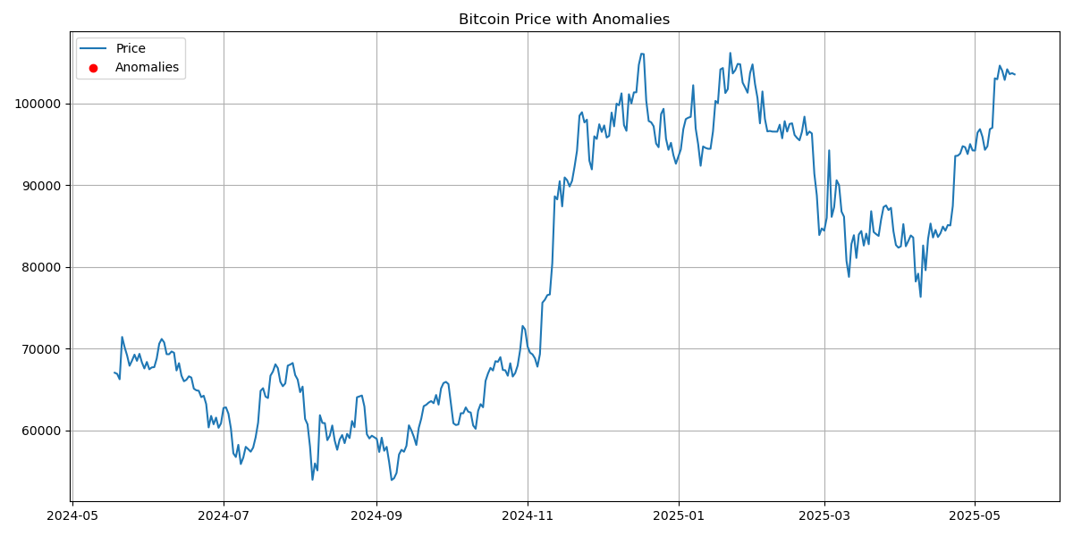
Anomaly Detection
I collected one year of daily BTC prices using the CoinGecko API, saved the data as bitcoin_prices.csv, and processed it with fetch_bitcoin_data.py and bitcoin_utils.py

Slide 9
Insights & Metrics
ARIMA SHOWED STRONG PREDICTION ACCURACY WITH STABLE TRENDS
DETECTED 5+ ANOMALIES POST-MARCH 2025 DIP
DATA WAS STORED AND LOADED FROM S3 VIA S3FS INTERFACE

Slide 10
Conclusion & Future Work
INSIGHTS
FEATURES
ENHANCEMENTS
Summarized key patterns and forecast behavior
Dashboard offers real-time monitoring
Future work: add more crypto support, use LSTM

Slide 11
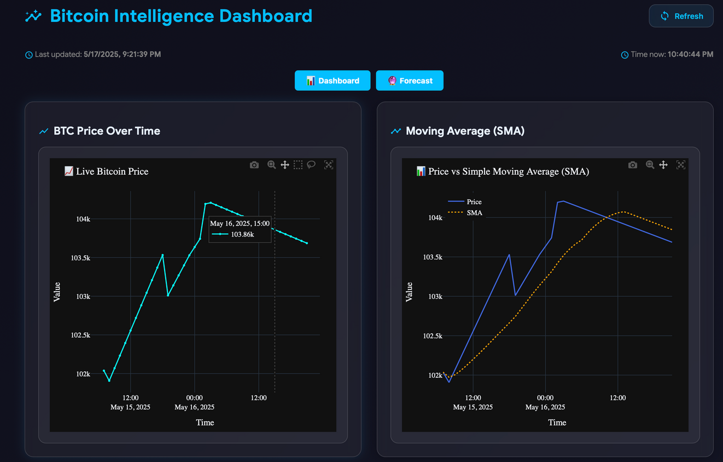
Bitcoin Intelligence Dashboard
CREATED USING FLASK + PLOTLY
FEATURES: PRICE TREND, ANOMALIES, MOVING AVERAGES, VOLATILITY, RETURNS
REFRESHABLE AND INTERACTIVE INTERFACE

Slide 12
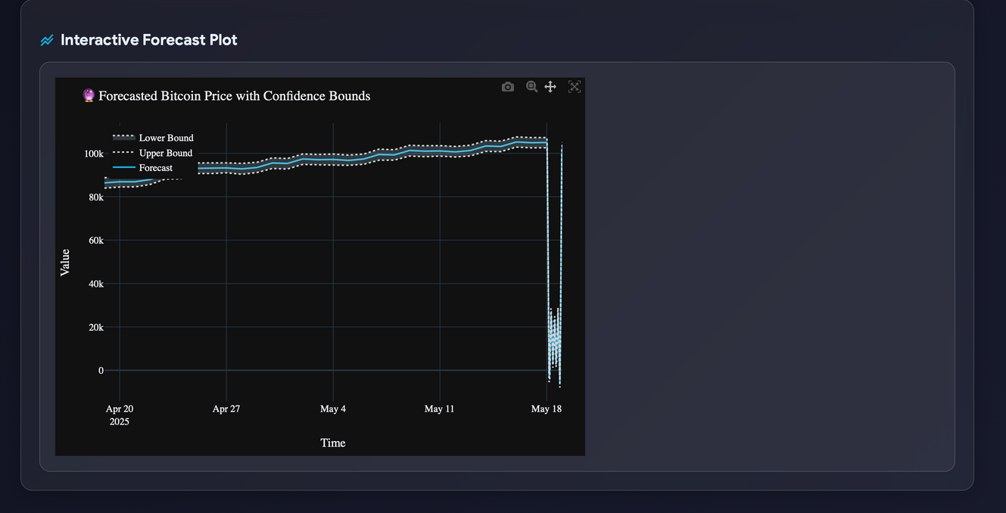
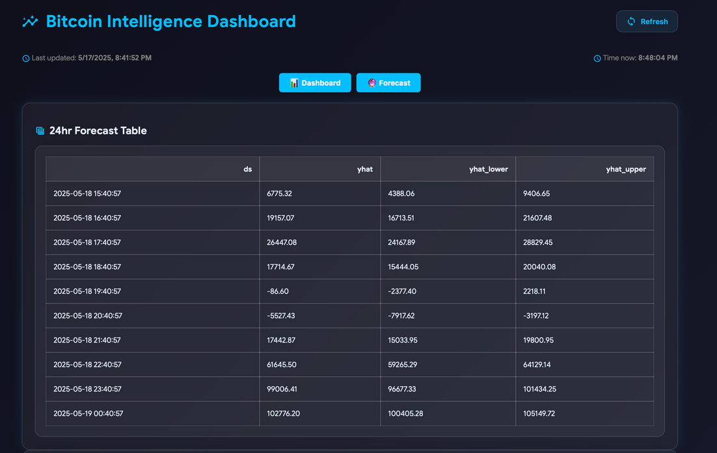
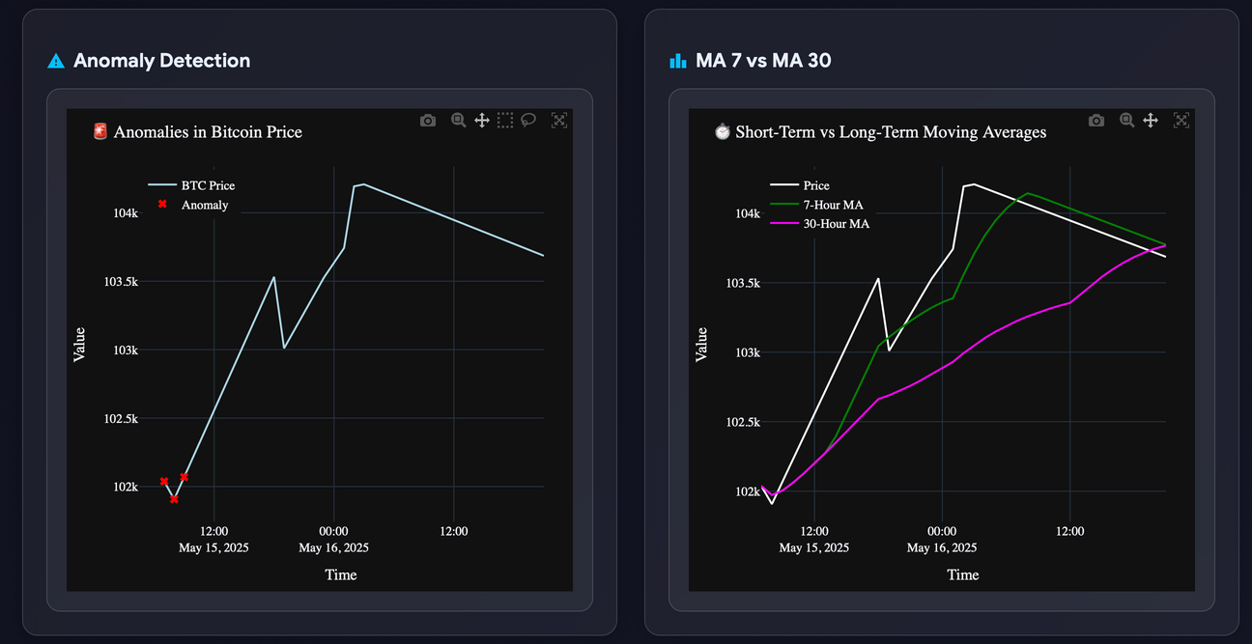
Live Dashboard Visuals
SMA & EMA comparisons, anomaly detection
Forecast table and plot with confidence bounds
Let me now walk you through the live demo...

